Slide 1
CSCI2100E Complexity for Recursive Algorithms

Slide 2











How to Count Basic Operations in Recursion?
Algorithm 1: BinarySearch(arr, searchnum, left, right)
1
2
3
4
5
6
7
8
9
10
11
12
13
if left = right
if arr[left]= searchnum
return left
else
return -1
middle ←(left + right)/2
if arr[middle] = searchnum
return middle
elseif arr[middle] < searchnum
return BinarySearch(arr, searchnum, middle+1, right)
else
return BinarySearch(arr, searchnum, left, middle -1)
$$O(1)$$
$$O(1)$$
$$O(1)$$
$$O(1)$$
$$O(1)$$
$$O(1)$$
$$O(1)$$
$$O(1)$$
$$O(1)$$
$$O(?)$$
$$O(?)$$

Slide 3

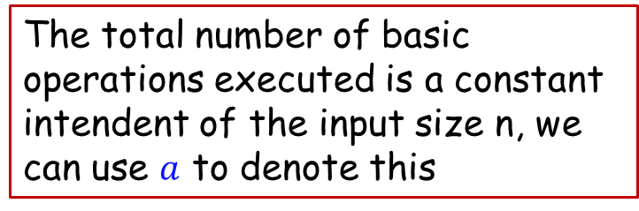
Complexity Analysis with Recursions
Given the input size $n$, let $g(n)$ be the total number of basic operations executed in BinarySearch
Algorithm 1: BinarySearch(arr, searchnum, left, right)
1
2
3
4
5
6
7
8
9
10
11
12
if left = right
if arr[left]= searchnum
return left
else
return -1
middle ←(left + right)/2
if arr[middle] = searchnum
return middle
elseif arr[middle] < searchnum
return BinarySearch(arr, searchnum, middle+1, right)
else
return BinarySearch(arr, searchnum, left, middle -1)
We can still count the number of basic operations for this part
The total number of basic operations executed is a constant intendent of the input size n, we can use $a$ to denote this
We either run line 10 or 12, but not both. What is the number of basic operations that are executed by Line 10 or 12?
Notes:
We either run line 10 or 12, but not both. What is the # of basic operations? Invoked by Line 10 or 12?

Slide 4

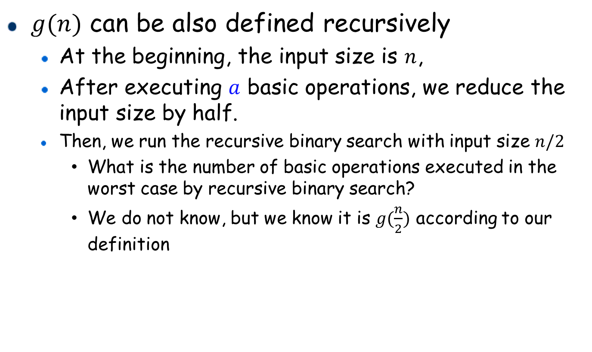


Analysis for Recursive Binary Search (i)
$g(n)$ can be also defined recursively
At the beginning, the input size is $n$,
After executing $a$ basic operations, we reduce the input size by half.
Then, we run the recursive binary search with input size $n/2$
What is the number of basic operations executed in the worst case by recursive binary search?
We do not know, but we know it is $g(\frac{n}{2})$ according to our definition
excluded
$$n$$
$$n/2$$
$$g\left(n\right)=a+g\left(\frac{n}{2}\right)$$

Slide 5
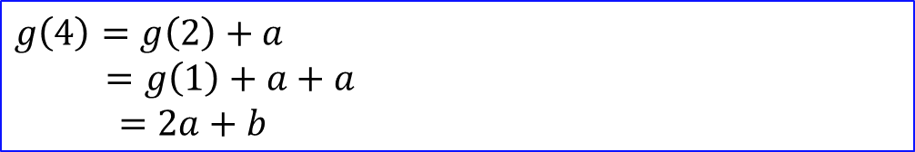



Analysis for Recursive Binary Search (ii)
Given $g\left(n\right)=a+g\left(\frac{n}{2}\right)$, $g\left(1\right)=b$
What is $g\left(4\right)$ by using $a$ and $b$ to represent?
What is $g(n)$ by using $a$ and $b$ to represent if $n=2^{x}$?
$g\left(4\right)=g\left(2\right)+a$
$=g\left(1\right)+a+a$
$=2a+b$
$g\left(n\right)=g\left(\frac{n}{2}\right)+a$
$=g\left(\frac{n}{2^{2}}\right)+a+a$
$=g\left(\frac{n}{2^{3}}\right)+a+a+a$
$=g\left(\frac{n}{2^{4}}\right)+a+a+a+a$
$=⋯$
$=g\left(1\right)+a+a+⋯+a+a=a{⋅log}_{2}{n}+b$
$\log_{2}{n}$ of them

Slide 6

Analysis for Recursive Binary Search (iii)
$g\left(n\right)=a⋅\log_{2}{n}+b$
What is the time complexity of $g(n)$?
$O(\log{n})$

Slide 7
Sorting with Recursion
Input: a set S of n integers
Problem: store S in an array such that the elements are arranged in ascending order
4 | 2 | 3 | 6 | 9 | 5
2 | 3 | 4 | 5 | 6 | 9

Slide 8

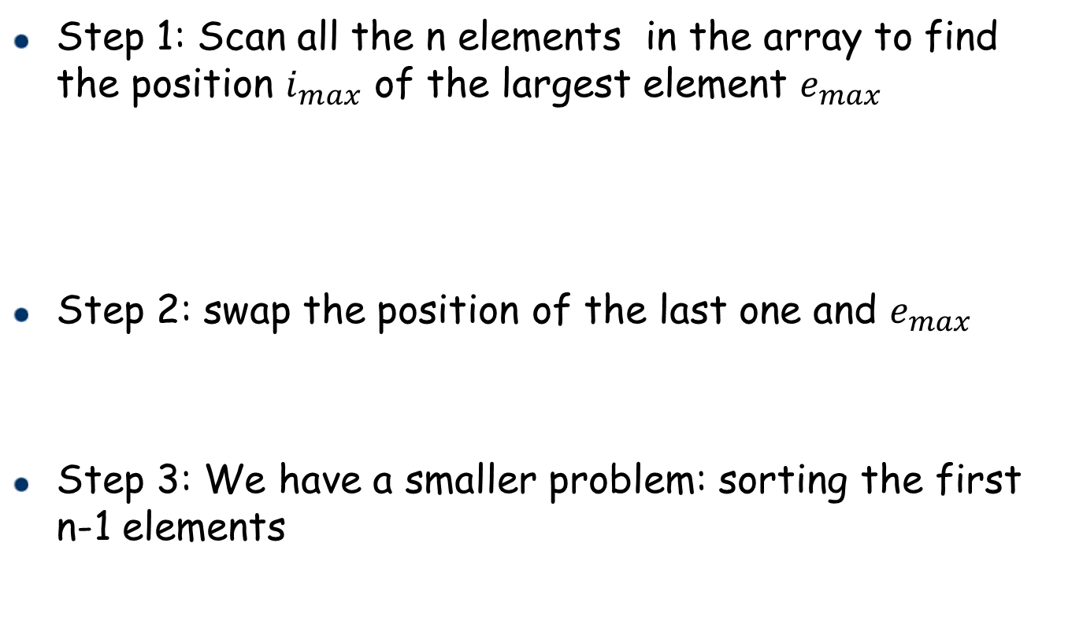
Selection Sort
Step 1: Scan all the n elements in the array to find the position $i_{max}$ of the largest element $e_{max}$
Step 2: swap the position of the last one and $e_{max}$
Step 3: We have a smaller problem: sorting the first n-1 elements
$i_{max}=4$, $e_{max}=9$
4 | 2 | 3 | 6 | 9 | 5
4 | 2 | 3 | 6 | 5 | 9
4 | 2 | 3 | 6 | 5 | 9
sorted

Slide 9
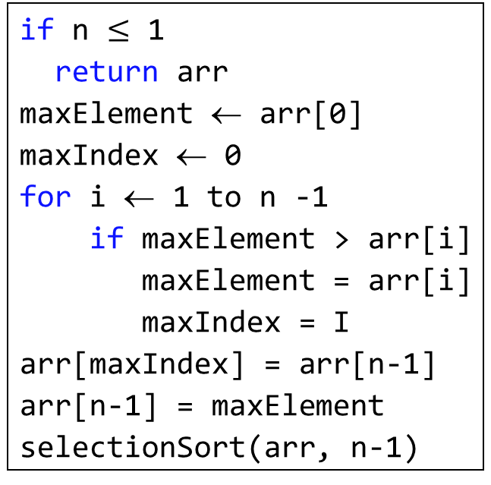
Selection Sort
Algorithm 2: selectionSort(arr, n)
1
2
3
4
5
6
7
8
9
10
11
if n $≤$ 1
return arr
maxElement ← arr[0]
maxIndex ← 0
for i ← 1 to n -1
if maxElement > arr[i]
maxElement = arr[i]
maxIndex = I
arr[maxIndex] = arr[n-1]
arr[n-1] = maxElement
selectionSort(arr, n-1)
maxElement =9
maxIndex = 4
maxElement =4
maxIndex = 0
maxElement =6
maxIndex = i
4 | 2 | 3 | 6 | 9 | 5
i=1
i=2
i=3
i=4
sorted
4 | 2 | 3 | 6 | 5 | 9

Slide 10





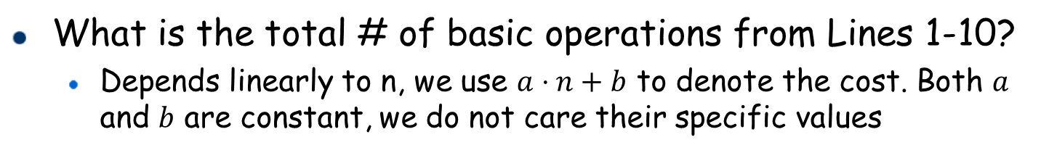







Selection Sort: Complexity Analysis
Algorithm 2: selectionSort(arr, n)
# of basic operations
1
2
3
4
5
6
7
8
9
10
11
if n $≤$ 1
return arr
maxElement ← arr[0]
maxIndex ← 0
for i ← 1 to n -1
if maxElement > arr[i]
maxElement = arr[i]
maxIndex = i
arr[maxIndex] = arr[n-1]
arr[n-1] = maxElement
selectionSort(arr, n-1)
$$O(1)$$
$$O(1)$$
$$O(1)$$
$$O(1)$$
$$O(n)$$
$$O(n)$$
$$O(n)$$
$$O(n)$$
$$O(1)$$
$$O(1)$$
$$O(?)$$
What is the total # of basic operations from Lines 1-10?
Depends linearly to n, we use $a⋅n+b$ to denote the cost. Both $a$ and $b$ are constant, we do not care their specific values

Slide 11
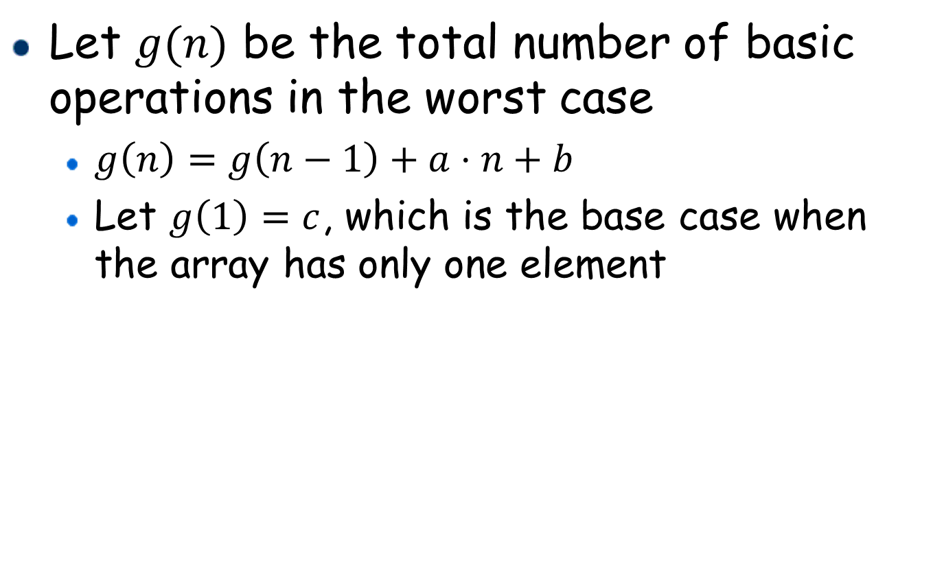
Analysis for Selection Sort (i)
Let $g(n)$ be the total number of basic operations in the worst case
$g\left(n\right)=g\left(n−1\right)+a⋅n+b$
Let $g\left(1\right)=c$, which is the base case when the array has only one element

Slide 12

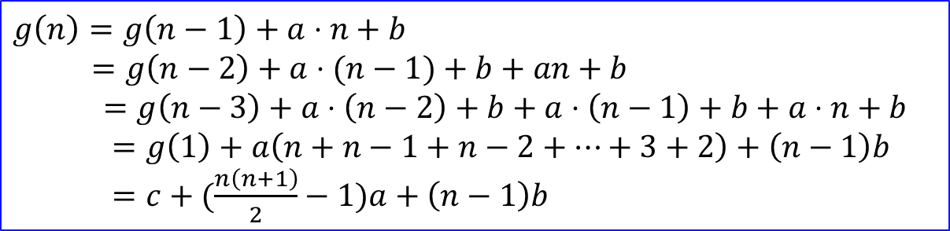
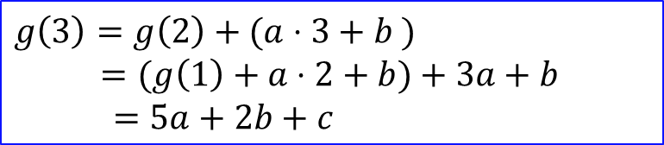
Analysis for Selection Sort (ii)
Given $g\left(n\right)=g\left(n−1\right)+a⋅n+b$ and $g\left(1\right)=c$
What is $g\left(3\right)$ by using $a$ and $b$ to represent?
What is $g\left(n\right)$ by using $a, b,$ and $c$ to represent?
What is the time complexity of $g(n)$
$O(n^{2})$
$g\left(3\right)=g\left(2\right)+(a⋅3+b )$
$=(g\left(1\right)+a⋅2+b)+3a+b$
$=5a+2b+c$
$g\left(n\right)=g\left(n−1\right)+a⋅n+b$
$=g\left(n−2\right)+a⋅(n−1)+b+an+b$
$=g\left(n−3\right)+a⋅\left(n−2\right)+b+a⋅\left(n−1\right)+b+a⋅n+b$
$=g\left(1\right)+a\left(n+n−1+n−2+⋯+3+2\right)+\left(n−1\right)b$
$=c+(\frac{n\left(n+1\right)}{2}−1)a+\left(n−1\right)b$

Slide 13

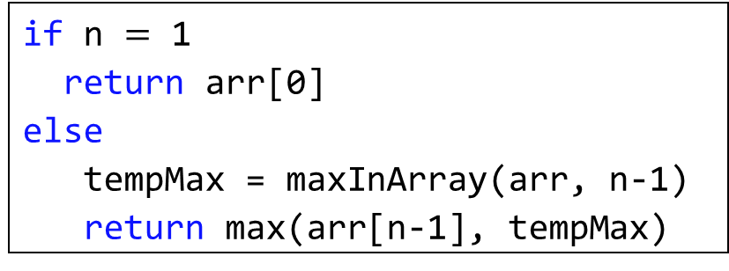

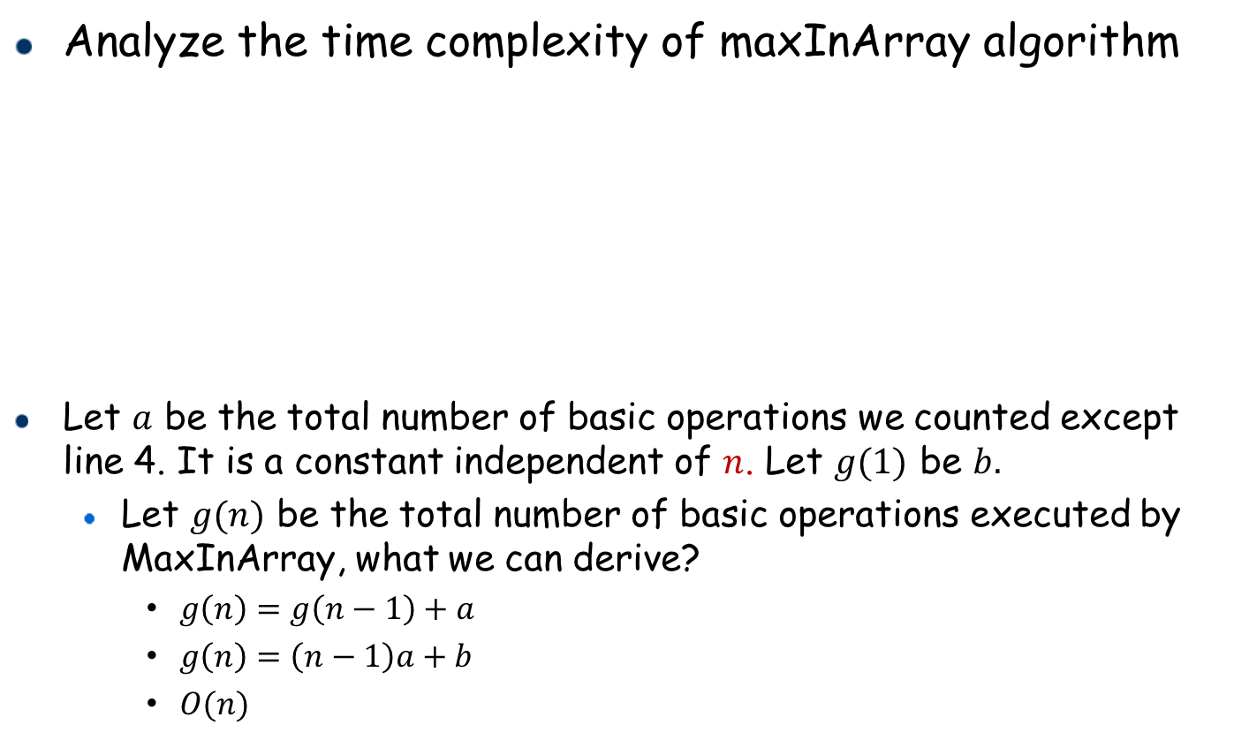



Practice*
Analyze the time complexity of maxInArray algorithm
Let $a$ be the total number of basic operations we counted except line 4. It is a constant independent of $n$. Let $g(1)$ be $b.$
Let $g(n)$ be the total number of basic operations executed by MaxInArray, what we can derive?
$g\left(n\right)=g\left(n−1\right)+a$
$g\left(n\right)=\left(n−1\right)a+b$
$O(n)$
# of basic operations
Algorithm 3: maxInArray(arr, n)
$$O(1)$$
1
2
3
4
5
if n $=$ 1
return arr[0]
else
tempMax = maxInArray(arr, n-1)
return max(arr[n-1], tempMax)
$$O(1)$$
$$O(1)$$
$$O(?)$$
$$O(1)$$

Slide 14
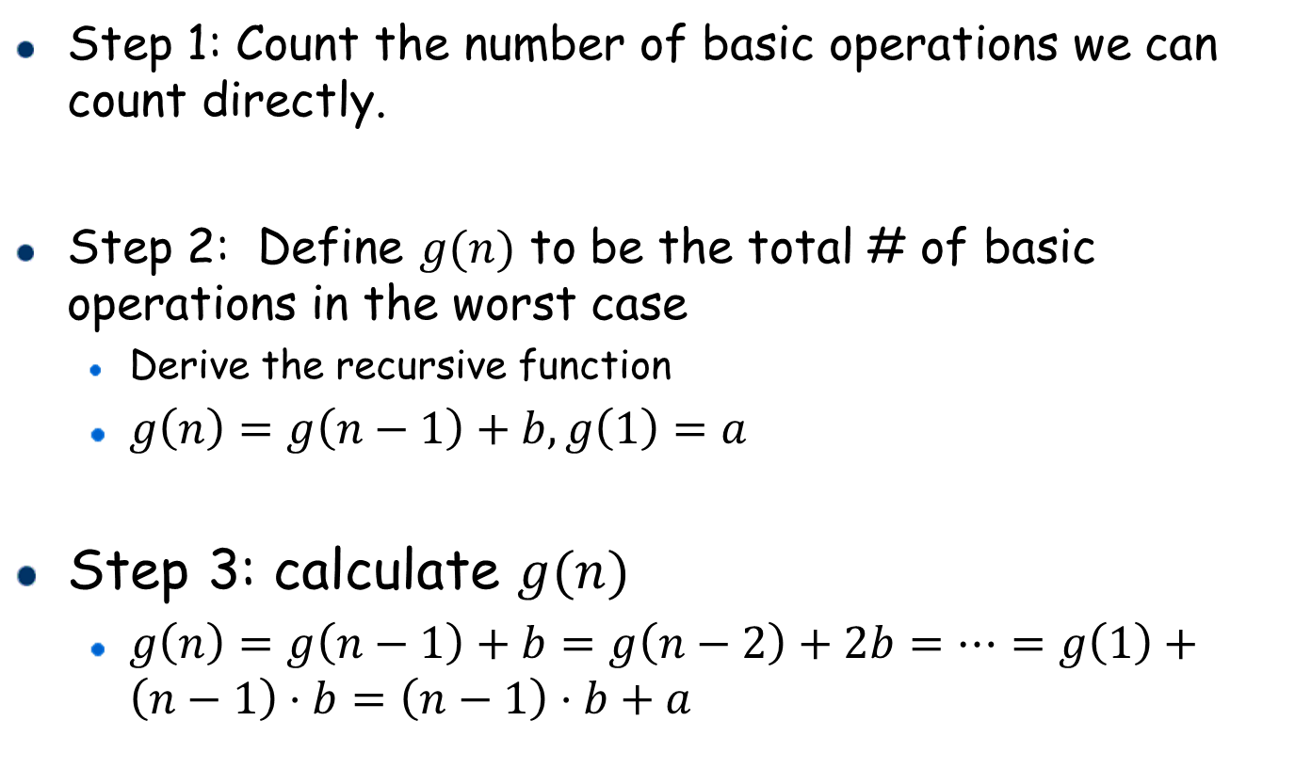
Summary: Complexity Analysis with Recursion
Step 1: Count the number of basic operations we can count directly.
Step 2: Define $g(n)$ to be the total # of basic operations in the worst case
Derive the recursive function
$g\left(n\right)=g\left(n−1\right)+b, g\left(1\right)=a$
Step 3: calculate $g(n)$
$g\left(n\right)=g\left(n−1\right)+b=g\left(n−2\right)+2b=⋯=g\left(1\right)+\left(n−1\right)⋅b=\left(n−1\right)⋅b+a$

